Slide 1



HLTWHS002
Follow safe work practices for direct client care (Release 2)

Slide 2

About this Unit of Competency
HLTWHS002 - Follow safe work practices for direct client care
This unit describes the skills and knowledge required for a worker to participate in safe work practices to ensure their own health and safety and that of others in work environments that involve caring directly for clients.

Slide 3



This unit applies to all workers who require knowledge of workplace health and safety (WHS) to carry out their own work, in both centre-based and home-based service provision.
The skills in this unit must be applied in accordance with Commonwealth and State/Territory legislation, Australian/New Zealand standards and industry codes of practice.

Slide 4

Presentation Objectives
At the end of this session, you will be able to:
Follow safe work practices for direct client care
Follow safe work practices for manual handling
Follow safe work practices for infection control
Contribute to safe work practices in the workplace
Reflect on own safe work practices

Slide 5
Introduction
Safety will always be a primary concern when working with and providing care for people.
In direct client care, you will be working as a care worker in community care or residential care setting which your roles and responsibilities will be focused on aiding clients who may require support.
They may require support due to ageing, disability or other reasons.
As a care worker, you will be working under a supervisor or as part of a team.

Slide 6
In community care, you will provide care and support to clients who visit or stay in a community care centre.
On the other hand, you will be visiting and providing care for clients in their own homes in residential care.
This is applicable in cases where clients choose to receive care at home or if, for any reason, they are restricted to staying at home.

Slide 7

Safe work practices are ways to perform your role in accordance with work health and safety standards.
These practices include how to follow procedures and do work tasks safely.

Slide 8
Work Health and Safety Legislation
These are based on national and state/territory WHS legislation.
WHS legislation and guidelines are in place to minimise or prevent health and safety risks in the workplace.
In general, WHS laws cover a wide variety of situations that workers in any field may encounter.

Slide 9
WHS is a set of legislation and guidelines that set best practices in:
protecting your own health and safety at work
preventing any threat to you and your colleagues’ health and safety
preventing any threat to the health and safety of the people you support and other members of the community.

Slide 10
Rights and Responsibilities of Workers
A set of rights and responsibilities governs your work.
Rights refer to your basic entitlements as a worker.
Responsibilities refer to what work you must perform and in what manner.
These rights and responsibilities are reflected in legislation and can also be found in the terms and conditions of your employment.

Slide 11
Your rights to work and rights in work are parts of your economic rights.
According to the International Covenant on Economic, Social and Cultural Rights (ICESCR), these rights include:
right to work
right to just and favourable conditions of work
right to initiate and participate in trade union activities.

Slide 12
You also have rights protected by legislation on:
discrimination
fair work
work health and safety
privacy and confidentiality.

Slide 13
You will be supporting people who may require your help due to ageing, disability or some other reason.
Your general work responsibilities will include the following:
Helping clients with everyday tasks that they may find difficult
Helping clients learn and develop life skills
Organising, scheduling and administering medication
Accompanying and supporting clients in fulfilling tasks and appointments
Coordinating client care needs with medical professionals

Slide 14
In addition to your role-specific responsibilities, you also have duty of care responsibilities.
Duty of care refers to your responsibilities, by law, in protecting the people in your care from harm.
In common law, you are found to have a duty of care when:
the welfare of other people is entrusted to you
it is possible that your actions or lack thereof may cause harm to the people under your care.

Slide 15
The nature of your work requires you to provide care for people, and so you have a duty to protect the people under your care from risks of harm.
You are responsible for:
identifying, minimising and eliminating possible sources of harm
supervising clients in daily activities to minimise their exposure to risks and hazards
checking equipment for any defects that may result in harm to users.

Slide 16

Rights and Responsibilities of Employers
Similarly, your employer will also have a set of rights and responsibilities.
Your employer is responsible for effective and compliant operation and delivery of services.

Slide 17
To meet this responsibility, they have the right to:
initiate, renew, suspend and terminate employees based on legal grounds
expect adequate work performance from employees according to agreed-upon standards
make changes to workplace policies and procedures if necessary.

Slide 18
However, remember that in the exercise of their rights, your employer must not violate your rights as an employee.
In the same way, when you exercise your own rights as an employee, you must not violate the rights of your employer.
Employers owe a duty of care to their employees.
They are responsible for the health and safety of everyone in the workplace.

Slide 19
In relation to WHS, your employer has the following responsibilities:
Providing a safe work environment
Providing safety equipment
Recording and resolving WHS issues and incidents
Providing safe work information, instruction, supervision and training
Coordinating with authorities

Slide 20
In relation to WHS, your employer has the following responsibilities:
Monitoring the health and welfare of employees
Coordinating with authorities regarding WHS concerns
Consulting employees on workplace safety concerns

Slide 21
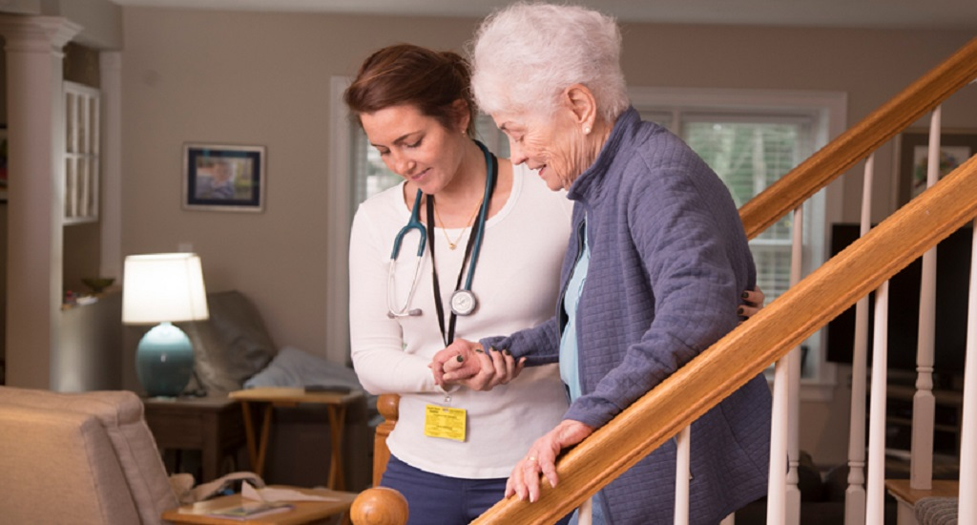
Follow Safe Work Practices for Direct Client Care
HLTWHS002 - Follow safe work practices for direct client care (Release 2)

Slide 22
Direct client care is your responsibility in supporting individuals in a range of health and community services.
You will be caring for individuals that require support in their everyday lives.
The sub-sectors of direct client care include the following:
Aged care
Home care
Disability care
Mental health care
Follow Safe Work Practices for Direct Client Care

Slide 23
Following safe work practices will ensure the safety and protection of your clients while under your care.
Failure to comply with these practices may result in risks of harming or allowing harm to clients.
This will result in legal and ethical compliance issues for you and your organisation.
Follow Safe Work Practices for Direct Client Care

Slide 24
In this chapter, you will learn how to:
follow workplace policies and procedures for safe work practices
identify, report and record existing and potential hazards in the workplace
identify, report and record any client-related risk factors or behaviours of concern
follow workplace policies and procedures to minimise risk
identify and report incidents and injuries.
Follow Safe Work Practices for Direct Client Care

Slide 25
Rights and Responsibilities of Workers and Clients in a Home-Based Environment
Depending on your organisational setup, your work may require you to provide care for clients in their homes.
But being a care worker, you also have rights and responsibilities in a home-based environment.
Follow Safe Work Practices for Direct Client Care

Slide 26
The table below shows the common rights and responsibilities of workers in in-home care.
Care Worker Rights | Care Worker Responsibilities
To adequate care information about their clients To privacy and confidentiality To be treated with dignity and respect | Provide care, support and assistance needed by clients. Provide care according to care plans. Ensure a safe and secure environment for all clients.
Follow Safe Work Practices for Direct Client Care

Slide 27
The table below shows the common rights and responsibilities of workers in in-home care.
Care Worker Rights | Care Worker Responsibilities
To complain about any risks of harm to self To work without discrimination | Respond to emergencies, risks and hazards. Inform clients of their care status and needs. Listen to and act on complaints made by clients regarding their care.
Follow Safe Work Practices for Direct Client Care

Slide 28
In the same way, your clients have rights and responsibilities when receiving home care.
These rights and responsibilities are based on legislation such as:
Aged Care Act 1997
Disability Services Act 1986.
Follow Safe Work Practices for Direct Client Care

Slide 29

1.1
Follow Workplace Policies and Procedures for Safe Work Practices

Slide 30
Your workplace will implement a set of policies and procedures.
These will guide you in performing your responsibilities according to safe work practices.
You must follow these workplace policies and procedures as you work.
Doing so is your way of ensuring that your organisation and its practices are legally compliant.
Follow Safe Work Practices for Direct Client Care

Slide 31

1.1.1 Workplace Policies and Procedures for WHS
Workplace policies are general rules that guide decisions and actions made in an organisation.
Follow Safe Work Practices for Direct Client Care

Slide 32
Policies:
are grounded on legal and ethical requirements, as well as the principles and values of the organisation
explain the concepts and ideas behind workplace processes and procedures
explain why workplace processes and procedures are performed and implemented a certain way
are based on legal and ethical requirements.
Follow Safe Work Practices for Direct Client Care

Slide 33
A workplace policy statement will include the following:
Purpose
Background
Definitions
Scope
Values
Responsibilities
Follow Safe Work Practices for Direct Client Care

Slide 34
Workplace procedures are specific actions that employees are required to perform.
Organisations set procedures for common workplace situations which must be align with related organisational policies and also based on legislation and guidelines.
Procedures may continuously change and improve.
They are reviewed and modified to better align with policies and industry best practices.
Follow Safe Work Practices for Direct Client Care

Slide 35
Procedures may be further broken down into the following parts:
Description
Step-by-step explanation
Potential hazards and risks
Safety precautions
Hazard and risk control measures
Follow Safe Work Practices for Direct Client Care

Slide 36
You must first access and read through workplace policies and procedures.
This will help you clarify your understanding of safe work practices.
Your organisation has policies and procedures related to different areas of workplace operations.
Safe work practices are covered in sections on WHS.
Follow Safe Work Practices for Direct Client Care

Slide 37
Consider the WHS policy for the simulated care organisation Lotus Compassionate Care (LCC).
LCC has procedures for different WHS practices, including those related to:
ergonomic requirements
critical incidents
decision-making and consent
reporting and notification
Follow Safe Work Practices for Direct Client Care

Slide 38
Consider the WHS policy for the simulated care organisation Lotus Compassionate Care (LCC).
LCC has procedures for different WHS practices, including those related to:
medication administration
emergency response
infection control.
Follow Safe Work Practices for Direct Client Care

Slide 39
1.1.2 Workplace Emergency Procedures
Workplace emergencies are unforeseen incidents in the workplace that may cause harm to people.
Emergency situations may include the following:
Fires
Explosions
Medical emergencies
Rescues
Incidents with hazardous chemicals
Bomb threats
Armed confrontations
Natural disasters
Follow Safe Work Practices for Direct Client Care

Slide 40
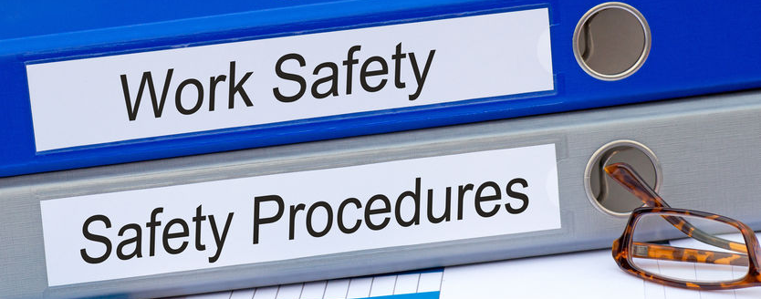
As part of WHS procedures, there are specific procedures to follow in cases of emergency.
WHS laws and regulations require organisations to provide an emergency plan for the workplace.
Follow Safe Work Practices for Direct Client Care

Slide 41
This emergency plan includes the following:
Emergency procedures
Notification of emergency service organisations
Medical treatment and assistance
Effective emergency communication and coordination
Evacuation procedures
Testing of emergency procedures
Information, training and instruction for workers
Follow Safe Work Practices for Direct Client Care

Slide 42
Each part of the emergency plan will contain important information:
Emergency procedures - what to do in cases of emergency
Evacuation procedures - what to do when the workplace must be evacuated
Notification of emergency service organisations - who to contact in cases of emergency
Medical treatment and assistance - how to provide treatment and assistance in medical emergencies
Follow Safe Work Practices for Direct Client Care

Slide 43
Each part of the emergency plan will contain important information:
Effective emergency communication and coordination - how to communicate and coordinate the emergency response to people in the workplace
Testing of emergency procedures - how to and how often to test if emergency procedures are effective
Information, training, and instruction for workers - what workers must know in emergency cases
Follow Safe Work Practices for Direct Client Care

Slide 44
You must have knowledge of the organisational protocols for emergency situations.
In summary, to ensure that you follow workplace policies and procedures, you must take the following steps:
Define and clarify your role in the organisation.
Look at the scope of policies and determine which responsibilities apply to your role.
Review and follow procedures related to your role and responsibilities.
Follow Safe Work Practices for Direct Client Care

Slide 45
1.1.3 Safety Considerations When Working in a Home-Based Environment
You may also be assigned to provide care in a home-based environment.
In this type of care, you will be providing support to individuals in their homes.
This will be the case for individuals who:
cannot visit a community care centre due to disability or incapacity
prefer to receive care in their own home instead of in a care centre.
Follow Safe Work Practices for Direct Client Care

Slide 46
In a home-based environment, there are two areas of safety considerations in relation to safe work practices:
Basic home fire safety
Risks to personal safety
Follow Safe Work Practices for Direct Client Care

Slide 47
1.1.3.1 Basic Home Fire Safety
Basic home fire safety refers to safe work practices to prevent or minimise the harm caused by fires.
If you are providing support in a home setting, it is important for you to know basic home fire safety because the individuals that you are supporting will likely be incapable of responding to fire hazards on their own.
Follow Safe Work Practices for Direct Client Care

Slide 48
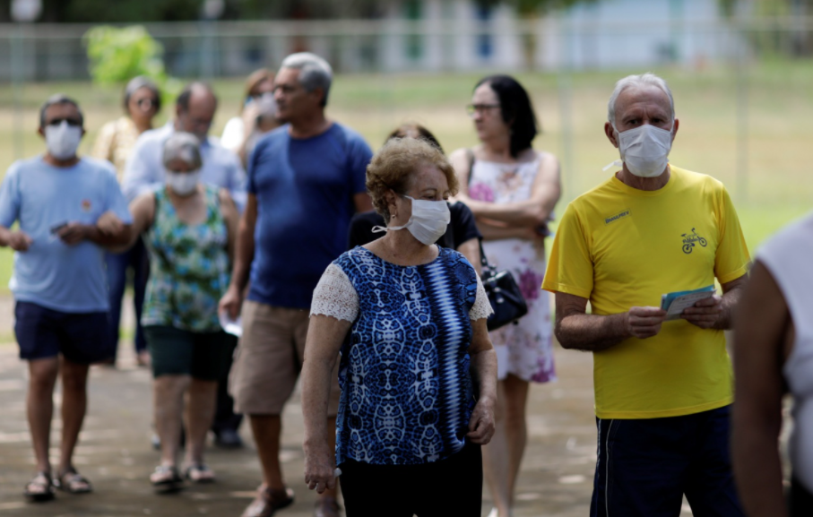
High-Risk Groups
High-risk groups are people in the home who are most vulnerable in cases of fire.
They are at high risk of injury or death due to fire.
They may lack basic capabilities such as mobility, mental capacity, hearing and eyesight.
Follow Safe Work Practices for Direct Client Care

Slide 49
High-risk groups include the following:
Children are at high risk of injury or death due to fire because they may not be physically and mentally developed to respond to fire.
Older adults refer to persons aged 65 years and above who tend to have deficiencies in mobility, eyesight, and hearing.
Persons with disabilities have conditions such as loss of eyesight, loss of hearing and loss or impaired ability to walk.
Follow Safe Work Practices for Direct Client Care

Slide 50
High-risk groups will find it more difficult to respond to fire emergencies due to their lack of physical and mental capabilities.
This is why you must always be ready to assist them in evacuation in cases of fire.
Aside from assisting them in evacuation, you must take note of certain fire safety measures which will prevent risks due to fire.
Follow Safe Work Practices for Direct Client Care

Slide 51
Fire safety measures for supporting high-risk groups include:
setting up their sleeping areas at the ground floor for easier access to exits
ensuring that fire detection systems, smoke alarms and sprinklers are well-maintained
ensuring that points of exit, such as doors and windows, are functional and free from obstructions
ensuring that they have means of communicating with you in cases of emergency (e.g. phones, walkie-talkies, intercom system).
Follow Safe Work Practices for Direct Client Care

Slide 52
Behaviour That Contributes to Fire Injury and Fatalities
Fire injuries and fatalities occur due to a lack of planning and preparation.
Without proper planning and preparation, you and the people under your care will not know what to do in cases of fire.
This may lead to panic and disorientation when a fire happens at home.
Follow Safe Work Practices for Direct Client Care

Slide 53
The following are some common behaviours that contribute to fire injury and fatalities at home:
Playing with or misuse of sources of fire such as matches, lighters and stovetops
Doing tasks that may cause fire, such as cooking, without the needed guidance and assistance
Using outdated or malfunctioning home/electrical appliances
Cluttering or obstructing points of exit
Not following fire emergency precautions and procedures
Follow Safe Work Practices for Direct Client Care

Slide 54
As a care worker, you must always be mindful of the actions of persons under your care.
You must also guide them in practising fire safety to ensure that they avoid behaviours that cause fire injuries and fatalities.
Follow Safe Work Practices for Direct Client Care

Slide 55
You can prevent this type of behaviour by:
orienting them about fire safety precautions such as fire escape plans and procedures
observing and monitoring their activities as much as possible
assisting them in performing tasks that may cause fire
ensuring that home/electrical appliances are well-maintained
ensuring that points of exit are always free from obstructions.
Follow Safe Work Practices for Direct Client Care

Slide 56
Smoke Alarm Placement, Installation and Maintenance
Smoke alarm placement is the process of locating smoke alarms so that they accurately alert home occupants of the presence of smoke.
Smoke alarm installation is the process of fitting and mounting smoke alarms.
These alarms should provide visual and auditory signals when smoke is detected.
Follow Safe Work Practices for Direct Client Care

Slide 57
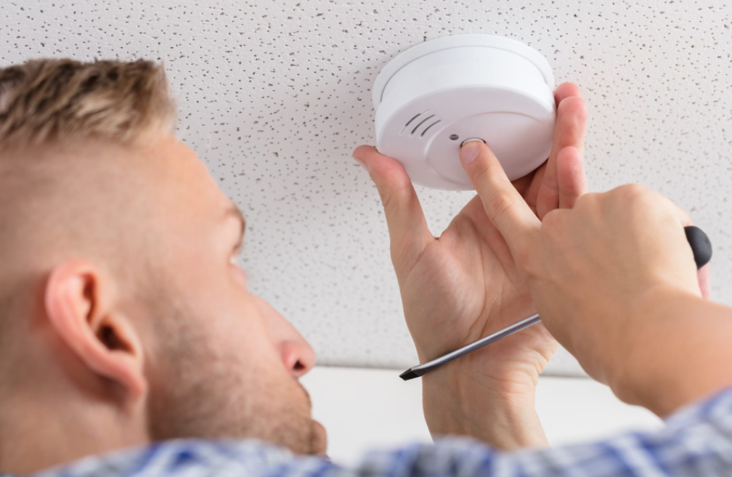
Installation also includes connecting alarms to the smoke detection system of the home.
Smoke alarm maintenance is the process of ensuring that smoke alarms are in working condition.
Follow Safe Work Practices for Direct Client Care

Slide 58
1.1.3.2 Risks to Personal Safety
Working in a home environment comes with risks to personal safety.
Risks to personal safety refer to possible sources of hazards found at home.
These risks include the following:
Fire
Water
Allergens
Trip and fall hazards
Choking hazards
Poisonous substances
Sharp objects
Follow Safe Work Practices for Direct Client Care

Slide 59
Fire
Fire is one of the most common risks to personal safety found at home.
This is because fire can come from a lot of possible areas:
Stovetops
Candles
Fireplaces
Heaters
Electrical equipment
Follow Safe Work Practices for Direct Client Care

Slide 60
Water
Water is a common provision at home that people use and consume for everyday tasks.
However, water can harm individuals who are not properly monitored.
Water can cause harm through drowning or electrocution.
At home, drowning may be caused by the use of pools, bathtubs, basins and other large water containers.
Follow Safe Work Practices for Direct Client Care

Slide 61
To avoid the risk of drowning:
secure sources and containers of water and keep them away from high-risk individuals
monitor high-risk individuals when they are near bodies of water.
Follow Safe Work Practices for Direct Client Care

Slide 62
Water may also cause risks of electrocution when in contact with electrical appliances and outlets.
To avoid the risk of electrocution, do the following:
Clean up water spills and puddles immediately to avoid possible contact with electrical appliances and outlets.
Monitor high-risk individuals and ensure that their hands are not wet when they handle electrical appliances.
Follow Safe Work Practices for Direct Client Care

Slide 63
Poisonous Substances
Poisoning can come from common household substances including cleaning substances, detergents, fuels and medications.
To avoid risks caused by poisonous substances, make sure that they are out of reach of high-risk individuals by storing these substances in a locked cabinet and label it with readable text properly.
Follow Safe Work Practices for Direct Client Care

Slide 64

Allergens
Allergens are food items or substances that cause allergic reactions for some individuals.
Follow Safe Work Practices for Direct Client Care

Slide 65
In the table below, you can see common food items and substances that may cause allergic reactions.
Common food allergens | Common substance allergens
Seafood Nuts Dairy products Fruits Eggs Poultry | Pollen Dust Animal fur Medicines Mould Detergents
Follow Safe Work Practices for Direct Client Care

Slide 66
You can avoid or reduce the risk of allergic reactions for persons under your care by keeping yourself informed of their medical history.
Read through the relevant medical records of individuals to identify their allergens.
This information will help you ensure that the persons under your care do not come into contact with these allergens.
Follow Safe Work Practices for Direct Client Care

Slide 67
You can identify allergic reactions through symptoms, including the following:
Sneezing
Coughing
Skin rashes
Breathing difficulty
Follow Safe Work Practices for Direct Client Care

Slide 68
Allergic reactions may cause serious medical risks if not identified and avoided.
If you think that the person under your care may be experiencing allergic reactions, perform the following steps:
Check their condition to see what aid you can provide immediately.
If possible, identify and remove the allergen.
Inform your supervisor.
Contact the individual’s doctor.
Follow Safe Work Practices for Direct Client Care

Slide 69
Trip and Fall Hazards
Trip and fall hazards are objects or settings at the home that may cause individuals to trip or fall.
These hazards include the following:
Stairs
Loose electrical cords
Loose rugs, carpets or fabrics
Clutter
Damaged or irregular floor surfaces
Follow Safe Work Practices for Direct Client Care

Slide 70
Choking Hazards
Choking hazards are items that may cause choking or suffocation when placed in the mouth of an individual.
Children under the age of five are especially at risk of choking on small items.
For older adults, choking may be caused by food items or medicines.
Follow Safe Work Practices for Direct Client Care

Slide 71
To avoid possible harm caused by choking hazards, you must do the following:
Make sure that small items that children can put inside their mouths are out of their reach.
Assist individuals when eating by cutting their food into smaller pieces for easy consumption.
Cut down medical pills and tablets into smaller pieces for easy consumption and help to dilute medicines in water so that individuals may consume them in liquid form.
Follow Safe Work Practices for Direct Client Care

Slide 72
Sharp Objects
Sharp objects are items that can possibly cut persons using them.
At a client’s home, common sharp objects include the following:
Knives
Forks
Saws
Razors
Metal wires
Fan blades
Follow Safe Work Practices for Direct Client Care

Slide 73
These objects are common household items, so it is not possible to eliminate them.
However, you may reduce risks associated with them by:
keeping sharp objects out of reach of high-risk individuals
cleaning up sharp objects immediately after use
assisting individuals when using sharp objects.
In addition to these common household items, damaged metal objects may also cause cuts.
Follow Safe Work Practices for Direct Client Care

Slide 74

1.2
Identify, Report and Record Existing and Potential Hazards in the Workplace

Slide 75
Part of your responsibilities as a care worker is to ensure your own safety as well as the safety of clients, co-workers and others in the workplace.
You can ensure safety through effective identification, reporting and recording of workplace hazards.
Follow Safe Work Practices for Direct Client Care

Slide 76
Hazards are objects, settings or situations that may potentially cause:
harm to people
damage to property
disruption to productivity.
Follow Safe Work Practices for Direct Client Care

Slide 77
Workplace hazards arise from the following:
Poor work design
Poor workplace environment design
Inappropriate systems and procedures
Inappropriate human behaviour and work practice
Follow Safe Work Practices for Direct Client Care

Slide 78
Workplace hazards come with risks.
Risk is an assessment of the probability of a hazard causing harm, damage or disruption in the workplace.
Your responsibility is to identify, report and record hazards and risks that you encounter at work.
When you promptly report and record hazards, your organisation can respond to eliminate these hazards.
Follow Safe Work Practices for Direct Client Care

Slide 79
1.2.1 Identify Existing and Potential Hazards
Hazards may be classified based on their current state.
Existing hazards are those that can cause reasonable harm to people in the workplace at its current state.
Potential hazards are those that may not cause any consequences at their current state.
However, these hazards may cause harm when under certain conditions or circumstances.
Follow Safe Work Practices for Direct Client Care

Slide 80
The common workplace hazards that you must recognise and identify are as follows:
Psychosocial hazards
Physical hazards
Chemical hazards
Ergonomic hazards
Biological hazards
Follow Safe Work Practices for Direct Client Care

Slide 81
Personal Safety Risks
Personal safety risks are threats to the welfare of people in the workplace.
Personal safety risks include the following:
Confrontations and harrassment
Burglary
Armed robbery
Theft of assets
Internal security issues
Follow Safe Work Practices for Direct Client Care

Slide 82
Personal safety risks include the following:
Suspicious mail packages
Bomb threats
Follow Safe Work Practices for Direct Client Care

Slide 83
Safety Symbols and Their Meanings
Another way of identifying hazards is through the interpretation of safety symbols.
Safety symbols:
are composed of standard and commonly used imagery related to health and safety
do not give straightforward written instructions
has assigned meaning through graphic elements such as colours and shapes
allow workers to identify hazards immediately.
Follow Safe Work Practices for Direct Client Care

Slide 84
Signs to identify procedures or actions are colour-coded as such:
‘DO NOT’ red circle and slash signs show that an activity is prohibited.
‘MUST DO’ blue circle signs show the PPE that should be worn.
‘BE AWARE’ yellow triangle signs warn about hazards in the area.
‘INFORMATION’ green square signs show information on emergency safety.
Follow Safe Work Practices for Direct Client Care

Slide 85
Safety symbols include symbols for:
poison
emergency protocols and equipment
personal protective equipment
specific hazards.
Follow Safe Work Practices for Direct Client Care

Slide 86
Workplace Procedures for Hazard Identification
In the workplace, the common way to identify hazards is through physical inspections.
Inspection involves observing work surroundings for existing or potential hazards.
This is usually part of the responsibilities of a supervisor or manager, but you may help by identifying hazards in your assigned work area.
By reporting any identified hazards to your supervisor, you will help yourself and others in the workplace in avoiding risks of harm.
Follow Safe Work Practices for Direct Client Care

Slide 87
You may identify hazards in the course of performing your other tasks.
Make sure to list down these hazards so that you can report them to your supervisor later on.
If the identified hazard presents immediate risks to health and safety, you must act to minimise or eliminate the hazard.
Follow Safe Work Practices for Direct Client Care

Slide 88
1.2.2 Report Hazards to Designated Persons
After identifying hazards, you must report this to designated persons in your workplace.
Designated persons are people in the workplace in charge of addressing hazards.
Depending on your organisational structure, the designated person may be in the following role:
A supervisor or manager
The health and safety representative (HSR)
Health and safety committee (HSC) members
Follow Safe Work Practices for Direct Client Care

Slide 89
After identifying the designated person, you may proceed with reporting the identified hazard.
To do this, you must follow your organisation’s procedure for hazard reporting.
Review your organisation’s policies and procedures and check the steps you must take in reporting hazards.
Follow Safe Work Practices for Direct Client Care

Slide 90
1.2.3 Record Hazards According to Workplace Procedures
After reporting hazards, you must also ensure that they are properly documented.
This will provide your organisation with a reference in case these hazards must be further investigated.
Hazard records are also useful references in conducting risk assessments for the workplace.
Recording hazards will also give you and your colleagues an idea of how to prevent the same hazards from reappearing in the workplace.
Follow Safe Work Practices for Direct Client Care

Slide 91
Your organisation may also have a procedure for recording hazards.
This is usually done using a hazard record or report form.
If there is such a form in your organisation, you may use that to record the identified hazard.
You may also be required to record hazards without a template, which means that you have to write the report from scratch.
This will be a simple task as long as you have all the details related to the hazard you have identified.
Follow Safe Work Practices for Direct Client Care

Slide 92
A basic hazard record will require you to provide the information shown in the table below:
Parts of a hazard record | Required information
Reporter’s information | Name Designation Supervisor’s name Contact details
Follow Safe Work Practices for Direct Client Care

Slide 93
A basic hazard record will require you to provide the information shown in the table below:
Parts of a hazard record | Required information
Hazard details | Date and time identified Location Description of the hazard
Follow Safe Work Practices for Direct Client Care

Slide 94
A basic hazard record will require you to provide the information shown in the table below:
Parts of a hazard record | Required information
Risk assessment | Possible injuries, illnesses and incidents resulting from the hazard, and their severity Likelihood of these injuries, illnesses and incidents Level of risk (e.g. low risk, moderate risk, high risk)
Follow Safe Work Practices for Direct Client Care

Slide 95
A basic hazard record will require you to provide the information shown in the table below:
Parts of a hazard record | Required information
Action plan | Description of the actions taken (if the hazard was immediately addressed) Suggestions for corrective actions or control measures (if the hazard has not been addressed at the time of writing)
Follow Safe Work Practices for Direct Client Care

Slide 96
A basic hazard record will require you to provide the information shown in the table below:
Parts of a hazard record | Required information
Action plan | Persons responsible for implementation Deadline for implementation
Follow Safe Work Practices for Direct Client Care

Slide 97
Risk Assessment
Assessing risks is an important part of hazard reporting.
Risk assessment will dictate if action must be taken to address hazards.
It will also determine how immediate the action must be implemented.
Access your organisation’s risk assessment form and fill out the required information.
Follow Safe Work Practices for Direct Client Care

Slide 98
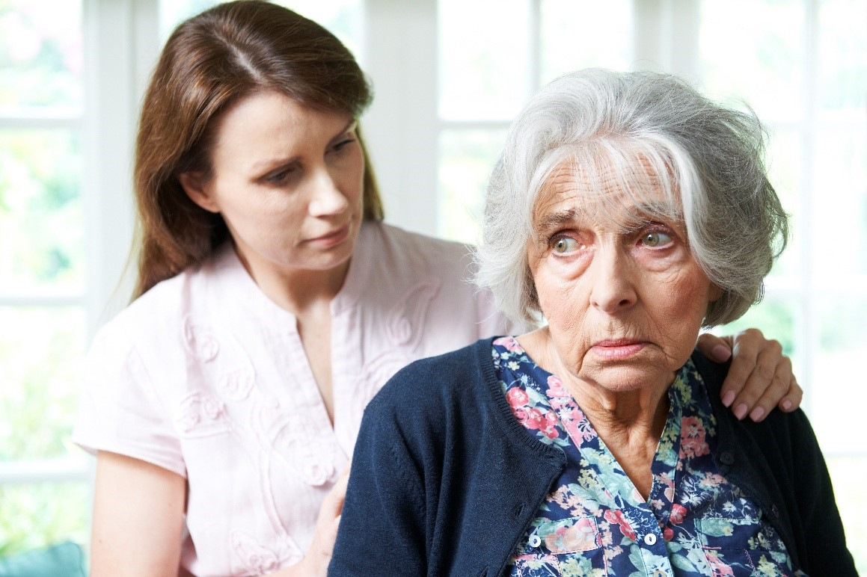
1.3
Identify, Report and Record Any Client-Related Risk Factors or Behaviours of Concern

Slide 99
When providing support and care for clients, it is important to be mindful of signs of risk.
You may recall that risk refers to how likely a certain hazard will result to harm.
As their care worker, you must be able to identify, report and record these hazards and risks to ensure that they do not result in harm.
Follow Safe Work Practices for Direct Client Care

Slide 100
1.3.1 Identifying Client-Related Risk Factors and Behaviours of Concern
Client-related risk factors are aspects of the condition and situation of the client which may lead to risks of harm to themselves or others.
These factors can be identified through:
hazard and incident reports
care plans
case management meetings.
Follow Safe Work Practices for Direct Client Care

Slide 101
Behaviours of concern are behaviour signs and patterns that may put the client or others around them at risk of harm.
These are often distressing behaviours that cause problems for the client and others.
A certain behaviour becomes a concern when it is already easily noticeable by carers and other observers.
This means that the behaviour is frequent or intense enough to cause concern.
You can also identify behaviours of concern through reports, care plans and case management meetings.
Follow Safe Work Practices for Direct Client Care

Slide 102
To identify client-related risk factors or behaviours of concern, you can follow the process shown in the diagram below.
Observe
Confirm
Report
Respond immediately
Follow Safe Work Practices for Direct Client Care

Slide 103
Observe
The first step is to identify the risk factor or behaviour of concern by observing clients.
You are going to be looking for factors that cause distress to the client or to people around them.
Follow Safe Work Practices for Direct Client Care

Slide 104
Common signs include the following:
Self-harming
Showing disinterest in activities
Breaking objects
Isolating from others
Harming others
Refusing to do things
Repeating actions or words
Raising their voice
Using threatening or violent language
Not talking for long periods of time
Follow Safe Work Practices for Direct Client Care

Slide 105
Note that during observation, you are not looking at the behaviour itself.
Rather, you are trying to identify if the behaviour is problematic.
You can do this by observing how the behaviour affects the client and people around them.
Follow Safe Work Practices for Direct Client Care

Slide 106
Respond Immediately
The first step is to identify the risk factor or behaviour of concern by observing clients.
You are going to be looking for factors that cause distress to the client or to people around them.
Follow Safe Work Practices for Direct Client Care

Slide 107
If you conclude that there is an immediate risk of harm, here are some actions you can take:
Distance yourself and others from the person causing the risk.
Try to calm the person down using prescribed communication techniques.
Give the person space.
Ask for help.
Follow Safe Work Practices for Direct Client Care

Slide 108
Confirm
After observing, and if you determine that there is no immediate risk to respond to, you must now confirm your findings.
You can do this by accessing the client records, specifically their care plans.
The care plan contains all information about the client that may help care workers administer care.
Follow Safe Work Practices for Direct Client Care

Slide 109
The care plan may include the following details about the client:
Social/family history
Care needs
Risks and behaviours of concern
Risk and behaviour response plans
Events and incidents
Development goals
Communication needs and preferences
Care history
Health support needs and plans
Progress notes
Follow Safe Work Practices for Direct Client Care

Slide 110
The client’s individual care plan serves as your manual in providing care specific to the needs and conditions of that client.
When reviewing the care plan:
confirm if your observed risk or behaviour of concern has been previously recorded
check if there are current actions being taken to address risks
If your observations are reflected in the organisation’s records, continue to follow the care plan.
Follow Safe Work Practices for Direct Client Care

Slide 111
1.3.2 Reporting Client-Related Risk Factors or Behaviours of Concern to Designated Persons
At this point, you have identified and confirmed risk factors or behaviours of concern and can do the following:
You must report your findings to designated persons.
You may be providing support as part of a team or under the supervision of a more experienced care worker.
You can report your findings to your direct supervisor.
You may share your findings with your teammates and colleagues.
Follow Safe Work Practices for Direct Client Care

Slide 112
Schedule a meeting with your supervisor or team to discuss your observations.
Your organisation may require you to attend regular meetings to share updates about the persons under your care.
Follow Safe Work Practices for Direct Client Care

Slide 113
When reporting client-related risk factors or behaviours of concern, you must:
give a background on the client’s care history and plan
discuss new observations and findings (i.e. information that is not currently in the care plan)
suggest an action plan based on your observations
seek comments and advice from your supervisors and colleagues.
Follow Safe Work Practices for Direct Client Care

Slide 114
It is important to report first and get the input of your team before performing any further assessments.
It is possible that you missed important details during your observation but your team can help you identify these details.
You must ensure that you have a clear picture of all risks and issues before you proceed with recording.
If you skip this step, you may risk recording incorrect or inaccurate assessments and action plans later.
Follow Safe Work Practices for Direct Client Care

Slide 115
1.3.3 Recording Client-Related Risk Factors or Behaviours of Concern
After reporting to your supervisor and team and getting their input, you will now record your findings.
Recording involves:
documenting and assessing the client-related risk or behaviour of concern
updating the client’s care plan to respond to risks.
Follow Safe Work Practices for Direct Client Care

Slide 116
Recording client-related risk factors or behaviours of concern will require a risk assessment.
You may be tasked to finalise and document the final record of risk assessment.
However, you do not have to conduct the risk assessment on your own.
In fact, it is best to perform the risk assessment in consultation with your team and supervisor.
Follow Safe Work Practices for Direct Client Care

Slide 117
Factors and behaviours, by definition, may cause harm to the client and people around them, you must assess risks.
Proper assessment will help in creating an action plan to address the risk or behaviour of concern.
Your findings will be added to the client’s care plan which can be use when providing support for this particular client.
Follow Safe Work Practices for Direct Client Care

Slide 118
After conducting and documenting the risk assessment, you must integrate these into the client’s records.
To review, the client’s care plan contains client information that may help care workers in providing care suited for the client’s needs.
Risk factors and behaviours of concern will require additional controls.
These controls must be added to the care plan for the reference of care workers who will work with the client in the future.
Follow Safe Work Practices for Direct Client Care

Slide 119

Recording According to Workplace Procedures
You have learned how to record client-related risk factors or behaviours of concern.
Note that your organisation will also implement certain procedures for recording risks.
Follow Safe Work Practices for Direct Client Care

Slide 120
Procedures in recording risks will include:
how to store records of risk factors and behaviours of concern.
how to conduct risk recording and assessment
what workplace documents or templates to use in recording
Follow Safe Work Practices for Direct Client Care

Slide 121

1.4
Follow Workplace Policies and Procedures to Minimise Risk

Slide 122

Once you have identified, reported, and recorded risks, you must act to minimise these risks.
Doing so will require you to follow policies and procedures.
Follow Safe Work Practices for Direct Client Care

Slide 123
1.4.1 Strategies for Minimising Risks
Policies and procedures for minimising risks are based on strategies for minimising risks.
Strategies are detailed plans of action with clear steps on how to minimise risks.
When handling risks in the workplace, you must follow two steps in order:
Eliminate risks so far as is reasonably practicable
Minimise risks so far as is reasonably practicable
Follow Safe Work Practices for Direct Client Care

Slide 124
You must first aim to eliminate the risk.
You can eliminate risk by removing the hazards associated with the risk.
Remember that hazards are objects, settings or situations that can cause harm to people.
Follow Safe Work Practices for Direct Client Care

Slide 125
The main strategies to minimise risk are the following:
Distancing people from risk-related hazards
Using mechanical methods to reduce risk
Using administrative methods to reduce risk
Using Personal Protective Equipment
Replacing the source of risk with a safer alternative
Follow Safe Work Practices for Direct Client Care

Slide 126
1.4.2 Workplace Policies and Procedures for Minimising Risk
Organisations implement strategies for minimising risks through workplace policies and procedures.
Policies are general guidelines and principles for minimising risks.
Policies guide the decisions and actions of an organisation.
Procedures are specific actions that employees can take to minimise risks which was based on policies.
Follow Safe Work Practices for Direct Client Care

Slide 127
To follow workplace policies and procedures for minimising risk, you must follow these steps:
Assess the risk and identify what topic of policies and procedures is related to the risk.
Access the related policies and procedures and determine what steps to take to minimise the risk.
Minimise the risk following instructions in policies and procedures.
Follow Safe Work Practices for Direct Client Care

Slide 128

1.5
Identify and Report Incidents and Injuries

Slide 129
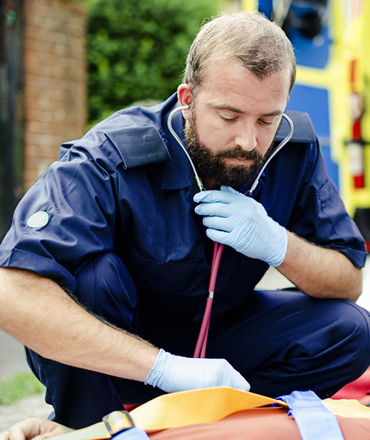
Another important set of procedures in the workplace relates to incident and injury response.
This will involve identifying and reporting incidents and injuries.
Follow Safe Work Practices for Direct Client Care

Slide 130
An incident occurs when a hazard is not controlled, thereby causing harm or risk of harm to people and it will require an immediate response from care workers and other designated persons to ensure that no further harm is caused to people.
An injury occurs when a person sustains damages to their body as a result of an incident.
Follow Safe Work Practices for Direct Client Care

Slide 131
Incidents and injuries are common in workplaces that involve a lot of movement.
It is important to identify and report incidents and injuries early.
This will ensure immediate response so that the persons involved do not experience further harm.
Follow Safe Work Practices for Direct Client Care

Slide 132
Some common causes of incidents and injuries in the workplace include:
unaddressed workplace hazards
overexertion due to intense or sustained physical effort
slips, trips and falls
malfunctioning equipment or misuse of equipment.
Follow Safe Work Practices for Direct Client Care

Slide 133
1.5.1 Identifying Incidents and Injuries According to Workplace Procedures
The process for identifying incidents and injuries is similar to those for hazards and risks.
The only difference is that for hazards and risks, identification is pre-emptive.
This means that you are identifying hazards and risks to minimise and prevent harm prior to anything happening.
In contrast, incidents and injuries refer to events that have already happened which means that you are identifying incidents and injuries to address the harm or damage they caused.
Follow Safe Work Practices for Direct Client Care

Slide 134
Incidents are dangerous occurrences that may cause injury or illness.
The following are some common incidents that you may encounter while working:
Fire or explosion
Equipment malfunction
Electrical shocks
Building/structure collapse
Severe weather conditions
Substance leakage/spillage
Spread of infectious diseases
Follow Safe Work Practices for Direct Client Care

Slide 135

For work health and safety, you must be particularly aware of notifiable incidents.
An incident is notifiable if it results in:
a person’s death
a person’s serious injury or illness
a dangerous incident.
Follow Safe Work Practices for Direct Client Care

Slide 136
The table below shows some common injuries that may result from incidents:
Injury | Description
Strain | Tearing of muscles due to overstretching
Bruise | Skin pain and discolouration caused by breaking of blood vessels
Sprain | Stretching or tearing of ligaments
Fracture | Breaking of bones
Concussion | Brain injury caused by head trauma
Follow Safe Work Practices for Direct Client Care

Slide 137
The table below shows some common injuries that may result from incidents:
Injury | Description
Cut | Tearing of the skin surface
Abrasion | Open skin wound caused by the rubbing of skin against a rough surface
Burn | Damage to layers of the skin and/or tissue caused by friction or heat
Follow Safe Work Practices for Direct Client Care

Slide 138
Your organisation will provide you with procedures to guide you in identifying incidents and injuries.
These procedures should also be covered during your pre-employment orientation.
Incidents and injuries may happen at any time, so you must always be prepared with the proper course of action.
Follow Safe Work Practices for Direct Client Care

Slide 139
Incident and injury identification will follow this general process:
Examine
Assess
Respond
What happened?
What are the immediate needs of the people involved?
Who is involved?
What steps must you take to address the immediate needs?
What are your possible courses of action?
Follow Safe Work Practices for Direct Client Care

Slide 140
Examination involves going to the site of the incident/injury and making observations to gather as much information as you can so you must prepare for a response by assessing the situation by:
identifying the people's immediate needs involved in the incident/injury
considering all your options for response and decide on the best course of action
responding to the incident/injury based on your assessment
responding first before reporting
Follow Safe Work Practices for Direct Client Care

Slide 141
Examination involves going to the site of the incident/injury and making observations to gather as much information as you can so you must prepare for a response by assessing the situation by:
ensuring that the people involved in the incident/injury get the care they need
ensuring that the incident site is safe and should not cause further harm to people in the area.
Follow Safe Work Practices for Direct Client Care

Slide 142
1.5.2 Reporting Incidents and Injuries According to Workplace Procedures
Incidents and injuries must be reported to designated persons.
In your case, you must report incidents and injuries to at least one of the following designated persons:
Your supervisor
Health and Safety Representative (HSR)
Health and Safety Committee (HSC) members
Follow Safe Work Practices for Direct Client Care

Slide 143

Supervisor
has the authority and experience to address different incidents and injuries
is familiar with different situations that you may encounter at work.
Follow Safe Work Practices for Direct Client Care

Slide 144
Health and Safety Representative (HSR)
is an employee elected as the representative in work health and safety matters
is responsible for ensuring that the organisation follows health and safety practices
helps you address incidents and injuries
helps you in recording incidents and injuries so that they can be prevented in the future.
Follow Safe Work Practices for Direct Client Care

Slide 145
Health and Safety Committee (HSC)
is in charge of discussing and addressing health and safety issues in the workplace
makes an advantage in all sectors of the workplace are well-represented
discusses different incidents and injuries
can implement decisions to address health and safety issues.
Follow Safe Work Practices for Direct Client Care

Slide 146
In reporting incidents and injuries, you must follow workplace reporting procedures.
Doing so ensures that the incident/injury is addressed correctly, without causing any further damage or harm.
Workplace procedures will inform you about what to do when you encounter an incident or injury.
Follow Safe Work Practices for Direct Client Care

Slide 147
Reporting to the WHS Regulator
There will also be incidents that will require the organisation to report to the WHS regulator.
You must notify your regulator about serious safety incidents.
To review, notifiable incidents are those that result in:
a person’s death
a person’s serious injury or illness
a dangerous incident.
Follow Safe Work Practices for Direct Client Care

Slide 148
For notifiable incidents, the employer has the duty to report to WHS authorities.
In your role, you must be aware of the proper line of reporting.
In the case of notifiable incidents, follow the usual reporting process to your direct supervisor.
Notifiable incidents are serious cases that require the attention of regulatory authorities which is important to report to your supervisor as soon as possible so that your employer can also fulfil their reporting duties.
Follow Safe Work Practices for Direct Client Care

Slide 149

What have we learned?
In this part of the session, we have covered:
Follow safe work practices for direct client care
Follow safe work practices for manual handling
Follow safe work practices for infection control
Contribute to safe work practices in the workplace
Reflect on own safe work practices

Slide 150
End of Chapter 1

